Slide 1

Introduction to the Consortium
Matthias Steinmetz (AIP)
Annual meeting of the German Astronomical Society
Splinter Meeting E-science and Virtual Observatory
22 September 2021
*Particles, Universe, NuClei
and Hadrons for the NFDI

Slide 2
Introduction

Slide 3
The PUNCH4NFDI Consortium
History
PUNCH4NFDI represents particle, astro-, astroparticle, hadron & nuclear physics
Built from ASTRO@NFDI und PAHN-PaN
> 9000 scientists with a Ph.D
Support from KAT, KET, KHuK, RdS
ASTRO@NFDI and PAHN-PaN not recommended for funding in first NFDI round, but
asked to hand in proposals in round 2
Reviewers pointed out clear strengths of both consortia
Together we are representing a large fraction of physics research („DFG-Fachkollegien“ 309 „Teilchen, Kerne und Felder“ , 311 „Astrophysik und Astronomie“)
also connections to 308, 310, 312, 313, 315, 409

Slide 4
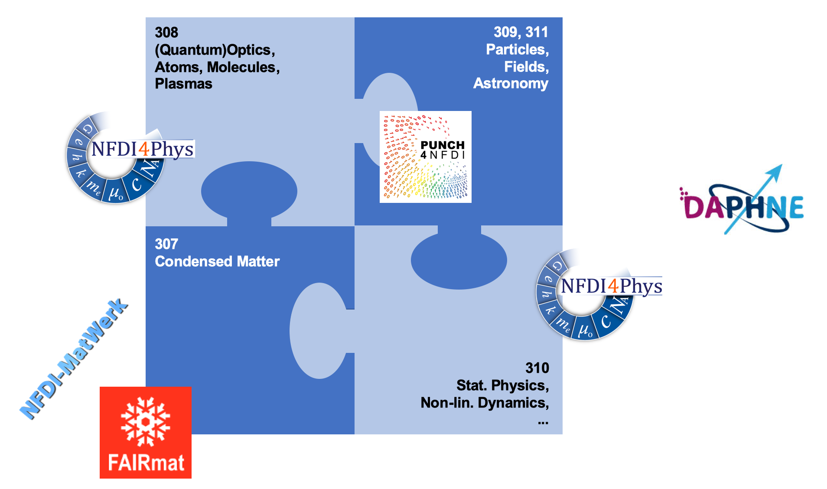
The PUNCH4NFDI Consortium
History
Relevance: 2 (+1) physics proposals in round 2 (PUNCH, FAIRMat, + DAPHNE) – how many will get funded?
One more proposal in round 3 (NFDI4Phys).

Slide 5
The PUNCH4NFDI Consortium
„Big data“ & „open data“ at large research infrastructures
PUNCH4NFDI: knowledge-oriented fundamental research in physics, in particular in the context of large research infrastructures
Key expertise needed for a successful national research data infrastructure (NFDI):
PAHN-PaN: „... Lösung konkreter, drängender Problemstellungen zur Erfassung, Verwaltung und Nutzung riesiger Datenmengen. Hier kann PAHN-PaN national wie international wichtige Impulse setzen und in der NFDI eine klare Vorreiterrolle einnehmen.“
ASTRO@NFDI: „Das Forschungsfeld Astrophysik kann in Bezug auf Metadatenstandards, das Kuratieren von Datensätzen und deren Qualitätskontrolle zudem auf langjährige Vorarbeiten und international koordinierte, etablierte Prozesse verweisen und nimmt damit innerhalb der Wissenschaftslandschaft klar eine Vorreiterrolle ein.“
Many features that are of interest for communities for which a elaborated data management was not in the main thrust of their activities
Strengths of PUNCH4NFDI:
Management of extremely large data sets.
Interoperability of diverse data sets, reusability of data(„open data“).
➔ FAIR data management very advanced; established standards will be used outside of the physical sciences
(e.g. Digitalization of the Vatican Library).
Merger of two initiatives – profitable process to jointly address research data management challenges.

Slide 6
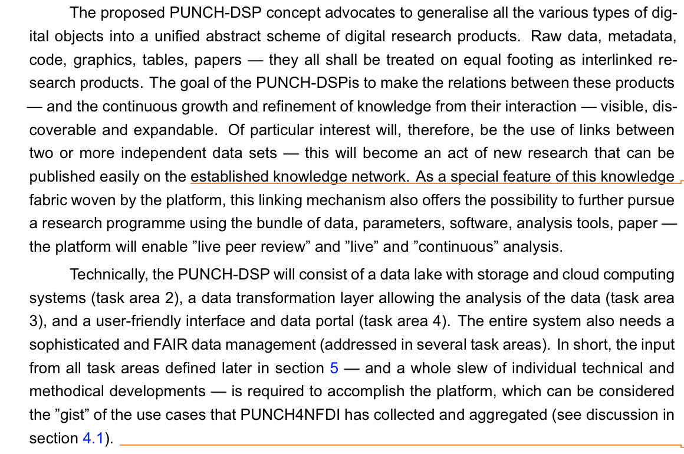
Central Objective: Data Science Platform
„Big data“ & „open data“ an großen Forschungsinfrastrukturen

Slide 7
FAIRness today
In PUNCH4NFDI – self-assessment
Depends on
Sub-field
Large – small experiments
Level of abstraction of data
Definition of what „data“ and „metadata“ are
...

Slide 8
The PUNCH4NFDI Consortium
Merging Astro@NFDI and PAHN-PaN
Not altogether painless, but very productive. Believed to be a true asset for our consortium.

Slide 9
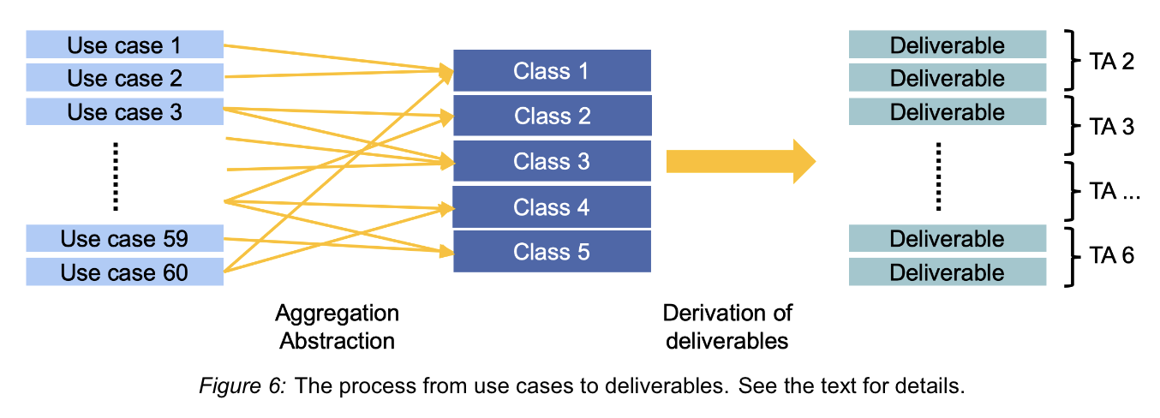
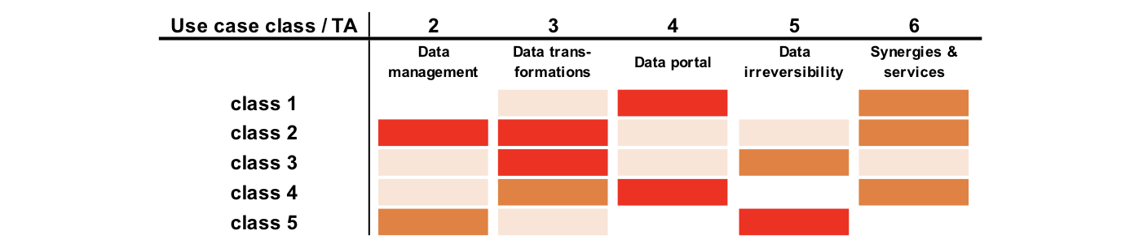
Use Cases as driving elements
Merging the consortia and structuring the work programme

Slide 10
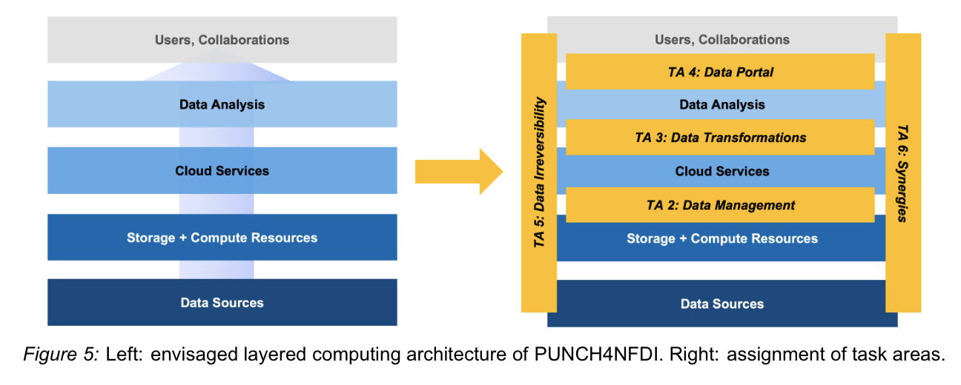
Computing Model
A layered approach as basis for our work

Slide 11
Task Areas
... Without much details
An ambitious work programme, addressing various aspects of an advanced layered data management model:
TA 2 ‘’Data management’’ provides solutions for standardised data access and inter-operable storage solutions; it addresses the integration of storage with federated compute resources, and it deals with dynamic and intelligent data handling for advanced workflows.
TA3 deals with the ‘’Data transformations’’ necessary for the maximum exploitation of scientific data, for the combination of different datasets, and for achieving higher levels of abstraction and thus new scientific insights.
TA 4 will provide the ‘’Data science portal’’ that provides access to a knowledge fabric connecting the elements of interlinked digital research products that are central elements of the PUNCH knowledge fabric. TA 5, finally, addresses the increasingly important issue of ‘’Data irreversibility’’ and the problems of data loss, the necessary ‘’real-time’’decisions and dynamical archiving capabilities.
The TAs 2-5 are accompanied by the TAs 6 and 7 on ‘’Synergies & Services’’ and ‘’Training, education, outreach, and citizen science’’ that address topics of relevance for the entireconsortium and for its connections to other consortia, to the entire NFDI, and to the public at large.
Next slides: Details on all task areas (but not yet adapted to latest developments in the consortium)

Slide 12
TAs in Detail

Slide 13

TA2: “Data Management”
Enable the analysis and processing of large, distributed Data volumes!
Scientific data obtained with modern experiments and telescopes are heterogeneous, distributed and of enormous volume (Pbyte → EByte).
To enable a broad community to use the data in an efficient and FAIR manner, we will develop standards and methods,
to integrate data sets and resources (storage and computing) in a Federated Science Cloud,
to make these data sets accessible to a wide range of users in a simple, uniform way
and to be able to connect the archived data with computing resources.
Experiments - User - collaborations
Tools for Data analysis
Batch systems, VMs, Container
Storage- and Compute-Middelware
TA 2
Hardware
Data Storage and Computing Resources

Slide 14





TA2: „Data Management“
  High energy physics:
  >170 dedicated grid centers, based on HTC architecture
  connected by dedicated network
  data storage at the centers
  Astrophysics:
  many distributed data archives, single observatories
  Data search via portals (e.g. NED, SIMBAD)
  Simulation data often not public
  globally distributed data lakes with access via portal
  additional (opportunistic) compute resources in a Federated Science Cloud.
  more complex data storage architecture (with data caches)
  Increasingly based on industry standards and compatible solutions
TODAY
FUTURE
Compute site
HPC with GPU
Grid site
CPU+Storage
Data archiv
Storage
Compute site
HPC
General-purpose site
CPU+storage
Datenarchiv
Storage
General-purpose site
CPU+storage
Grid site
CPU+Storage
Data Lake
HPC
Compute site
Cloud
HPC
Data portal
https://..

Slide 15
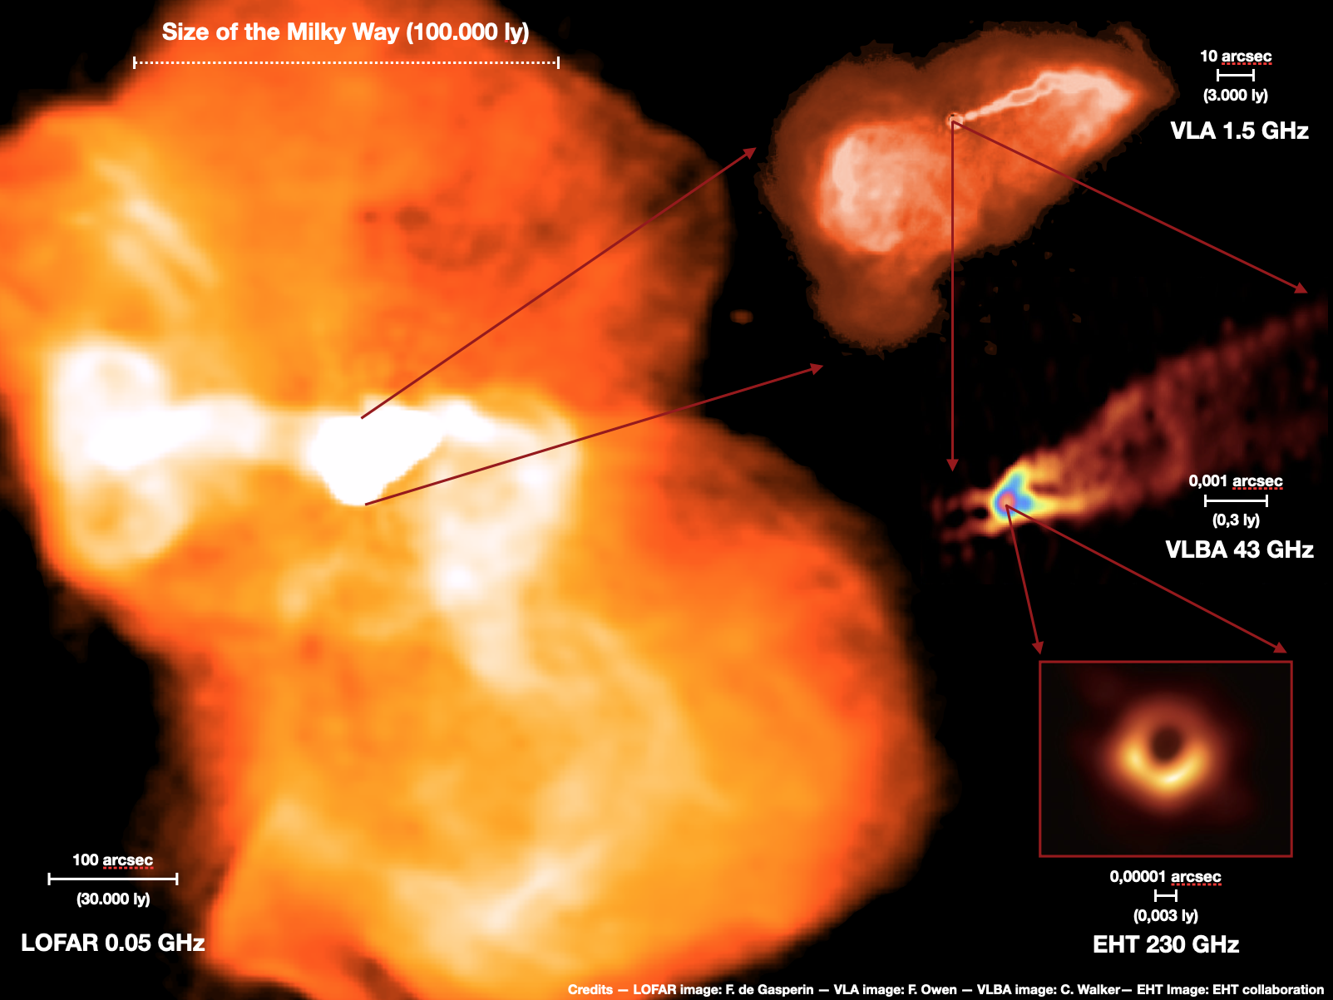
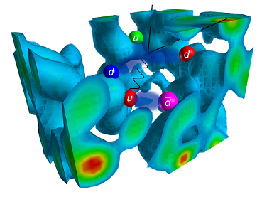
TA3: “Data Transformations”
Methods to maximize the scientific value of data
Algorithms: crucial role in extracting scientific knowledge from data.
Algorithms often very specific to the scientific problem at hand
Numerous methods used in many PUNCH data analyses and also applicable beyond PUNCH ⇒ Topic of TA 3!
Statistical methods
Resource-efficient adaptation of complex models with many parameters to huge data sets
Measurement of tiny signals against large backgrounds
⇒ Examples of expertise: Bayesian Analysis Toolkit, Origins Data Science Lab
Numerical Methodes
Solution of equations with large matrices
Optimizations for specific hardware architectures
⇒ Examples of expertise: Lattice QCD computations with an optimized multi-grid equation solver for exascale hardware and performance porting across multiple architectures
Derek Leinweber, CSSM, University of Adelaide

Slide 16
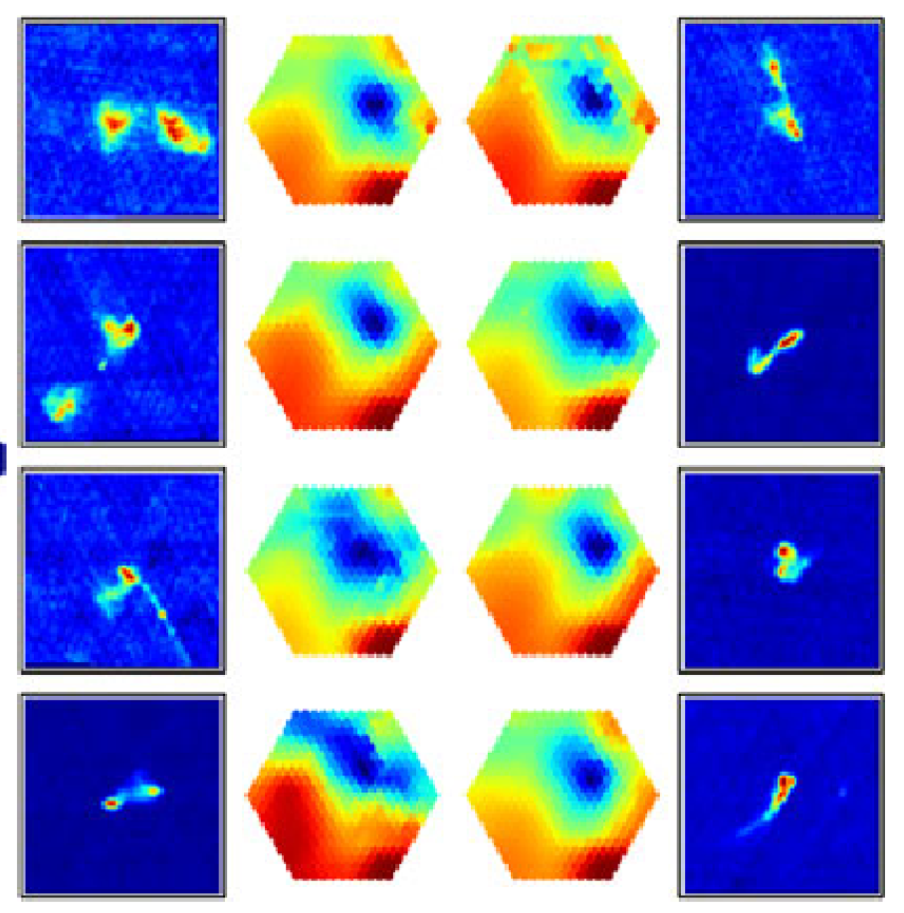
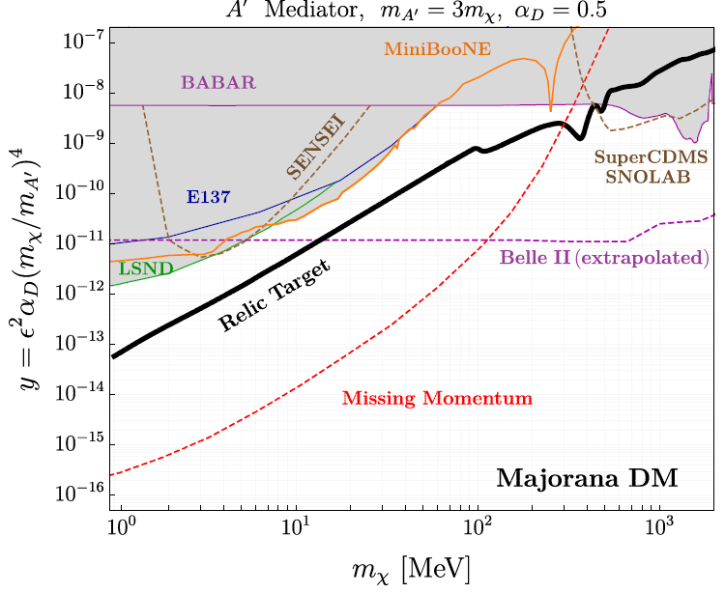
TA3: “Data Transformations “
Polsterer, et. Al (2016)
Methods to Maximize the scientific value of data
Machine Learning
Automated optimization of model hyper parameters for a wide variety of problems
Distributed learning with very large (petabyte) partitioned data sets
Interpretation, reliability and visualization of resuls from machine learning algorithms
Examples of expertise: Inter-Experimental LHC Machine Learning Working Group, coordination of the ML activities of the CMS experiment, Platform for Challenges in Data Science
Analysis of multiple data
Interface to determine physical properties or likelihoods from data sets
Combination of likelihoods and comparison with theoretical predictions
Examples of expertise: Fittino, Heavy Flavor Averaging Group, multi-wavelength astro/cosmo analyses (DES, SPT, eROSITA, MeerKAT)
arXiv:1808.05219

Slide 17
TA 4: Data Science Portal
FAIR access to data and analysis workflows
PUNCH has a large variety of data
from astronomical image to detector signal
Data set size ranges from MB to PB
deep integration of data, metadata, analysis software
PUNCH addresses common issues
requires more joint and open analysis
open data and common metadata standards are necessary but not sufficient
Cross-experimental analyses require integration of (meta)data, simulation data and analysis software
PUNCH requires sustainability
Combination of open analyses with persistence of analysis and data necessary
⇒ from experiment specific data preservation to common workflows and procedures
Deliverables:
User-level access to open data, metadata and analysis tools according to FAIR principles
Organization of access rights and user management for internal and public access
SCIENCE PORTAL: Web- and API-based user interface for (interactive) application of algorithms to (large) data sets, combined statistical analysis of different data sets, based on developments in TA2/3/5/6 and external projects (e.g. IVOA, KCDC, CERN Open Data, ARCHIVER, REANA, etc.)
Tools and services for access, analysis and preservation of data from multiple experiments.

Slide 18
TA 4: Data Science Portal
FAIR access to data and analysis workflows
So far:
Data, meta data and analysis tools in separated, at times incommensurable formats on separated portals
combination of the outcomes of various experiments often only at the level of final results
Vision of the PUNCH Science Data Platform: consistent open data, meta data and experiment-independent analysis tools and services via a joint platform
Main aim: consistent global analyses of experiments, Persistence of Data und analysis, and adaption to very different abstraction levels of data: from raw data to a likelihood
Guidance from existing global analyses; enabling these previously individual projects in an open portal with open and standards-based software
Transfer to other sectors: global analyses of a wide range of data from various sources, e.g. in Earth Science, medicine; provision of the data, the portal, e.g. for mathematics
TA 4
FAIR
Data,
Meta-data,
Analysis-tools
User Access to
data and analysis
services
Data and Analysistools,
Preservation
Open community and standard based APIs
Experiment-Independent Platform
Users
Univer-sities
User Manage-ment,
Access Rights,
Accoun-ting
Labs
Experi-ments
TA2 Services
TA3 Workflows
External Resources+ Services

Slide 19
TA5: „Data Irreversibility“
Tomorrow‘s challenge: dynamic archives
The challenges demand dynamic and scalable data lifecycles.
Data irreversibility: fundamental impact on the reproducibility of scientific results.
Fast growing data rates require optimized resource utilization: co-design of hardware & software, new selection algorithms, methods, architectures.
TA5 interacts with TAs 2-4: Enabling science facing the age of next generation large data sets.
Significance beyond NFDI: e.g. green computing: important contributions to reducing the currently rapidly increasing power consumption of cloud computing.
Distributed
Sensors
Distributed
Sensors
Distributed
Sensors
Dyn.
Archiving
Scaling Workflows
Dyn.
Filtering
Regional Computing
Regional Computing
Central Computing
Regional Computing
Archives
Archives
Data Products
Archives
Dynamic data live cycle

Slide 20


TA6: Synergies & Services
PUNCH4NFDI unites several sub disciplines
PUNCH4NFDI has extensive experience in the management of large amounts of data:
Most data originates from international research infrastructures.
An integration of FAIR principles requires coordination between the different disciplines of the consortium, with other NFDI consortia and with international partners.
Objectives:
Identification and exploitation of synergies
Exchange of concepts for data management
Avoid multiple developments
Coordination of technical solutions and management principles with the other consortia

Slide 21
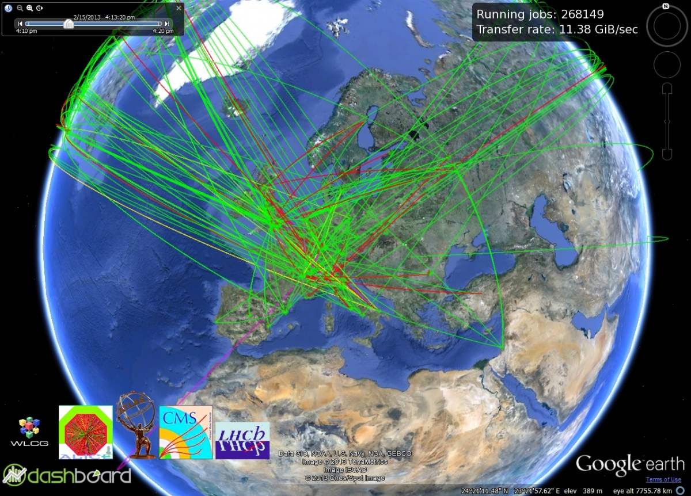
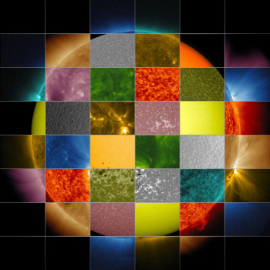
TA6: Synergies & Services
PUNCH4NFDI unites several sub disciplines
Astrophysics
Leading in open access and broad, multiple use of research data from distributed infrastructures.
Users can combine data from diverse archives to study objects in various wavelength ranges.
Particle physics
Advanced services for data management on globally distributed systems.
Handling Exabyte volumes and millions of transactions daily.
Further developments with the aim that other research fields within and outside the PUNCH sciences benefit from existing and future services and solutions.

Slide 22
TA6: Synergies & Services
Interactions with other fields and NFDI consortia
NFDI e.V.
NFDI4Earth
Archäologie
  Data analysis with mathematical methods
  Optimization algorithms
Examples:
existing cooperations
Chemie
MaRDI
Meteorologie
NFDI4Phys
PUNCH4NFDI
Zellbiologie
NFDI4Health
NFDI4CS
  Application of neuronal networks and AI/ML methods
  opportunistic resources of national HPC centers
  DOI infrastructure
DAPHNE
FAIRmat

Slide 23
TA6: Synergies & Services
Interactions with international und interdisciplinary partners
PUNCH4NFDI
Partners are multipliers
International
cooperations:
NFDI e.V.
NFDI4Earth
TIB:
Libraries
Compute
Centers:
DESY, FZJ,
GSI, KIT,
LHLRZ,
MPCDF
Organisations:
AG, DPG
EU:
EOSC,
EOSC-Hub, -Pilot,
ESCAPE,
HNSciCloud,
INDIGO, …
Archaeology
Chemistry
MaRDI
Meteorology
NFDI4Phys
PUNCH4NFDI
Cell biology
GEANT
WLCG
VO-Aliance, ...
NFDI4Health
CERN,
ESO, ESA
CTA, SKA, ...
NFDI4CS
DAPHNE
International
Infrastructures:
FAIRmat

Slide 24
TA7: Training, Education & Public Outreach
Preparation for data challenges and promotion of data science expertise, for professionals, students, pupils and the general public.
Challenges
Research: Education in data science on the project, learning by doing as needed, not very sustainable.
Career: Brain drain owing to lack of career options, lower pay, gender gap.
University: physics curricula lack data science, big data management and advanced programming
Public outreach: Dependent on sporadic resource allocation and lack of national coordination
Public: participation rather passive, little everyday context and basics.
Physics at school: Declining student numbers, gender gap, lack of data science.
Mission
Identify and address short and long-term needs in formal, vocational and public education and training
Guidance and support w.r.t the implementation of best practices, career advancement, gender equality
Provide and coordinate open access to data and training resources; establish a hub and contact point for information and activities.
Coordination and initiation of educational, outreach and citizen science programs in existing and new structures.

Slide 25
Training
Education
Outreach
Citizen Science
Experts
Support expert knowledge and career development
Provide data and teaching resources
Universities:
Teachers and Students
Focused support for education and career deveopment
Education and data resources, on-site and online seminars
Scientists, Media, School, Public
communicate,
support young talent, strengthen schools
Communication training, school-academy networks, events, Resources
Amateurs
Public
To further engagement & understanding „democratize“ research
Online projects and –campaigns
Target
Goal
Measures

Slide 26
Other General Remarks

Slide 27
Collaborations with Other Consortia
List not yet final
Already now established numerous collaborations with other consortia – important for the development of a future comprehensive NFDI:
MaRDI (mathematics)
NFDI4HPC/NFDIxC
NFDI4Earth
NFDI4Ing
NFDI4Microbiota
NFDI4Culture
(DAPHNE)
(FAIRMat)
...

Slide 28
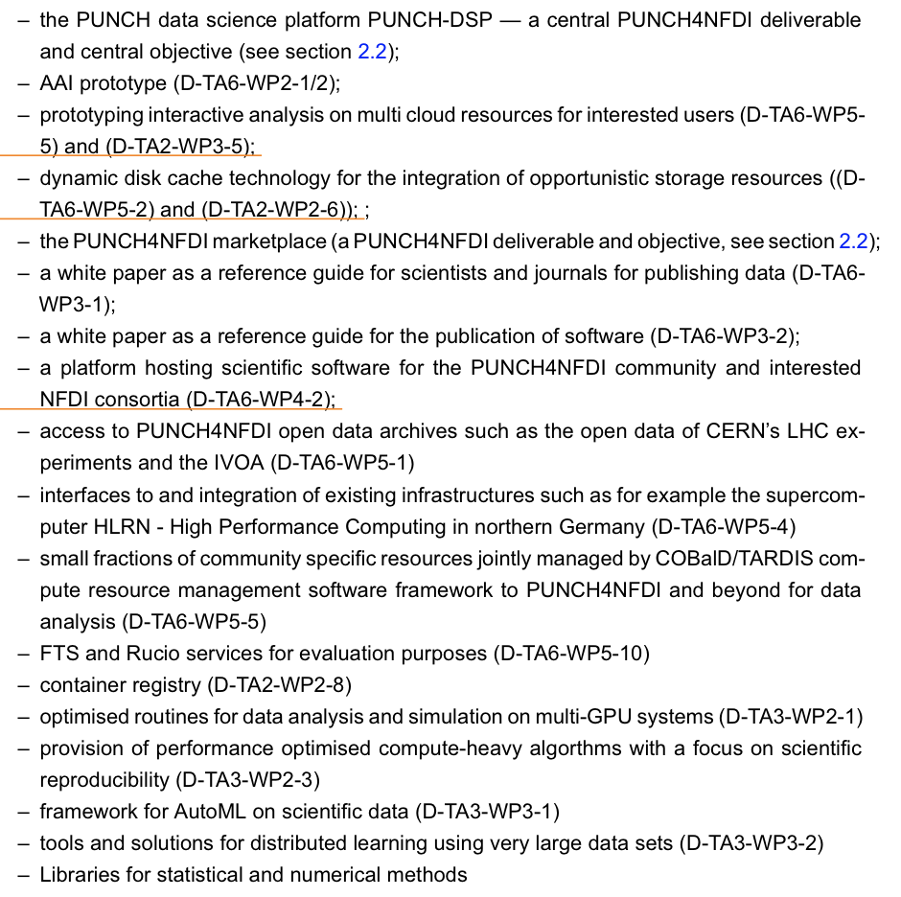
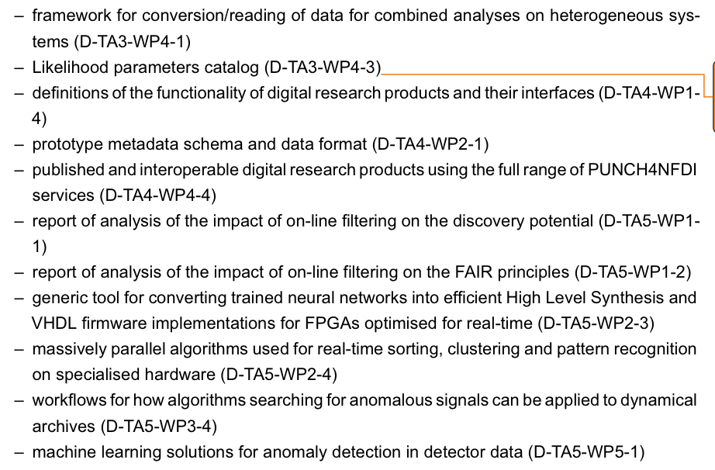
Services
Offered by PUNCH4NFDI
Defined so far – more will come in the
course of the consortium:

Slide 29
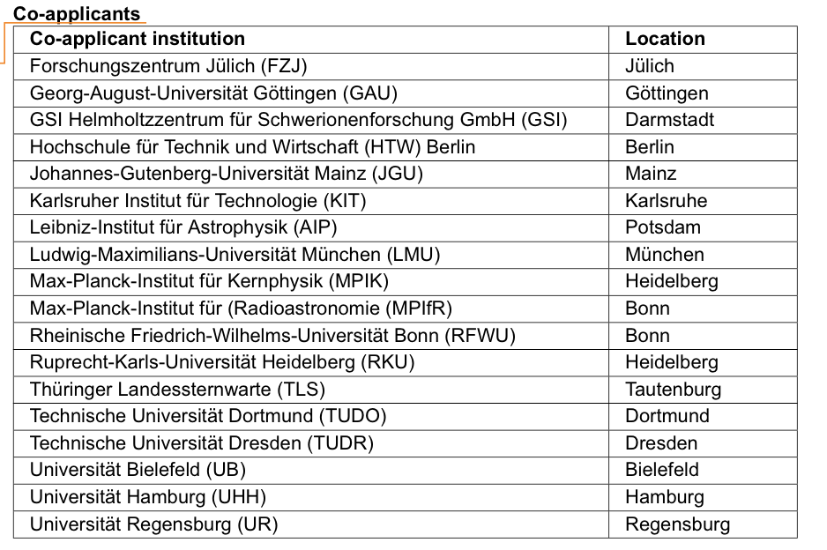
Co-applicants
As of today

Slide 30
Interested Institutions
List not yet final
Universities
RWTH Aachen, HTW + HU Berlin, Bielefeld, Bochum, Bonn, Braunschweig, Darmstadt, Dortmund, Dresden, Erlangen, Frankfurt, Freiburg, Gießen, Göttingen, Hamburg, Heidelberg, Jena, KIT Karlsruhe, Köln, Mainz, LMU + TU München, Münster, Potsdam, Regensburg, Siegen, Würzburg, Wuppertal
Leibniz Institutes
AIP Potsdam, KIS Freiburg, TIB Hannover
Max Planck Institutes
MPA, MPE, MPIK, MPIM, MPIfR
Helmholtz Centers
DESY, DLR, FZ Jülich, GSI, HZDR, KIT
Supercomputer Centers
GridKA/SCC, JSC, LRZ, MPCDF
Other Institutes
FIAS Frankfurt, TLS Tautenburg
Organisationen
AG, DPG, KAT, KET, KHuK, RDS, VdR
International Research Infrastructures
CERN, Belle II, CTA, ESO, FAIR, Fermilab, IceCUBE, LOFAR, KATRIN, LSST, Pierre Auger, SKA

Slide 31
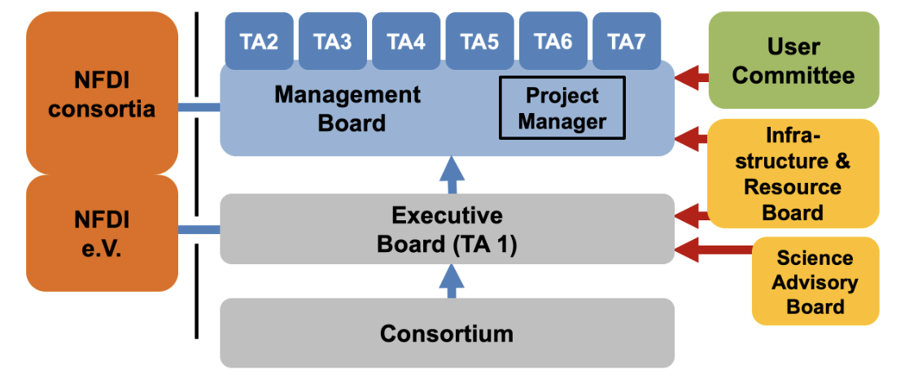
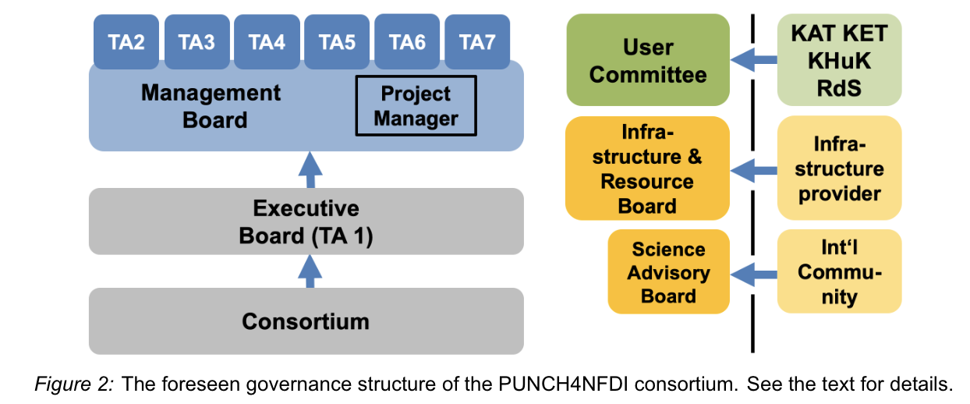
The PUNCH4NFDI Consortium
Governance

Slide 32
Thank you!
The PUNCH4NFDI Consortium
Spokespersons:
PD Dr. Thomas Schörner (DESY, thomas.schoerner@desy.de)
Prof. Dr. Matthias Steinmetz (AIP, msteinmetz@aip.de)

Slide 33
Backup

